Slide 1


Slide 2


Slide 3
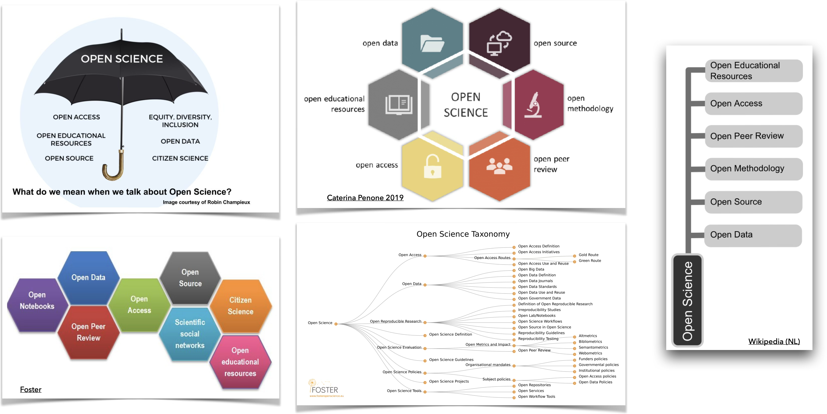

Slide 4


Slide 5
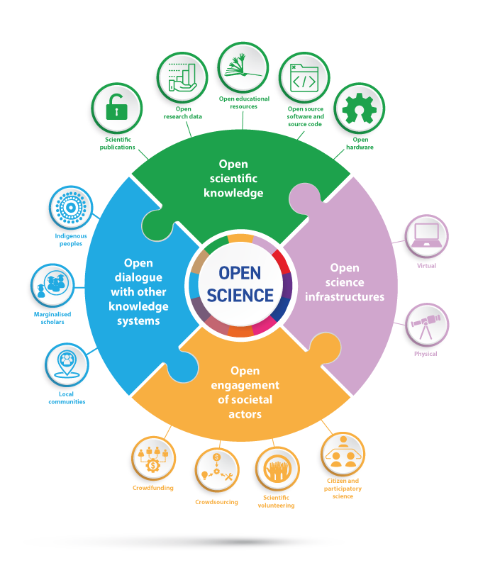

Slide 6
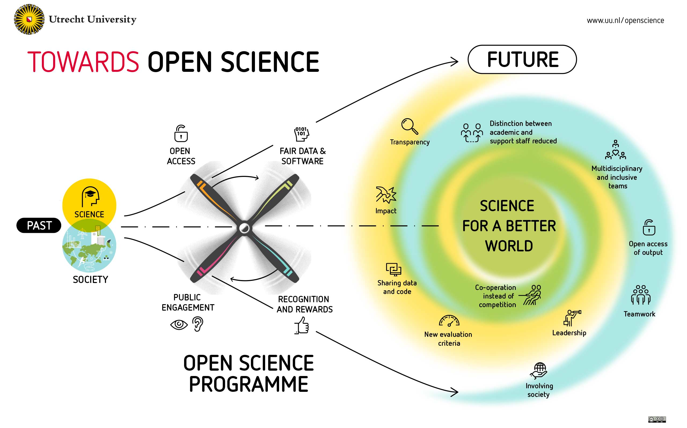

Slide 7


Slide 8
“No, I’ll get scooped!”
“We should all adopt OS practices”
Policy makers
“Yes, but how?”
“I’m already practising OS”
Researchers
Notes:
And one way to get more people involved,might be by having OS policies in place on a local, national and international level. However, simply having policies in place will not automatically make people adopt open science practices.

Slide 9
Rogers (1962)
Notes:
It is thought that Open Science thus improves the way we conduct science. For over a decade, researchers that were intrinsically motivated to conduct OS, have been involved in open science practices. However, the transition to OS has been slow. For large scale adoption of OS practices it is important that we reach people beyond the innovators and early adopters. We need people just outside of the OS bubble get involved.

Slide 10
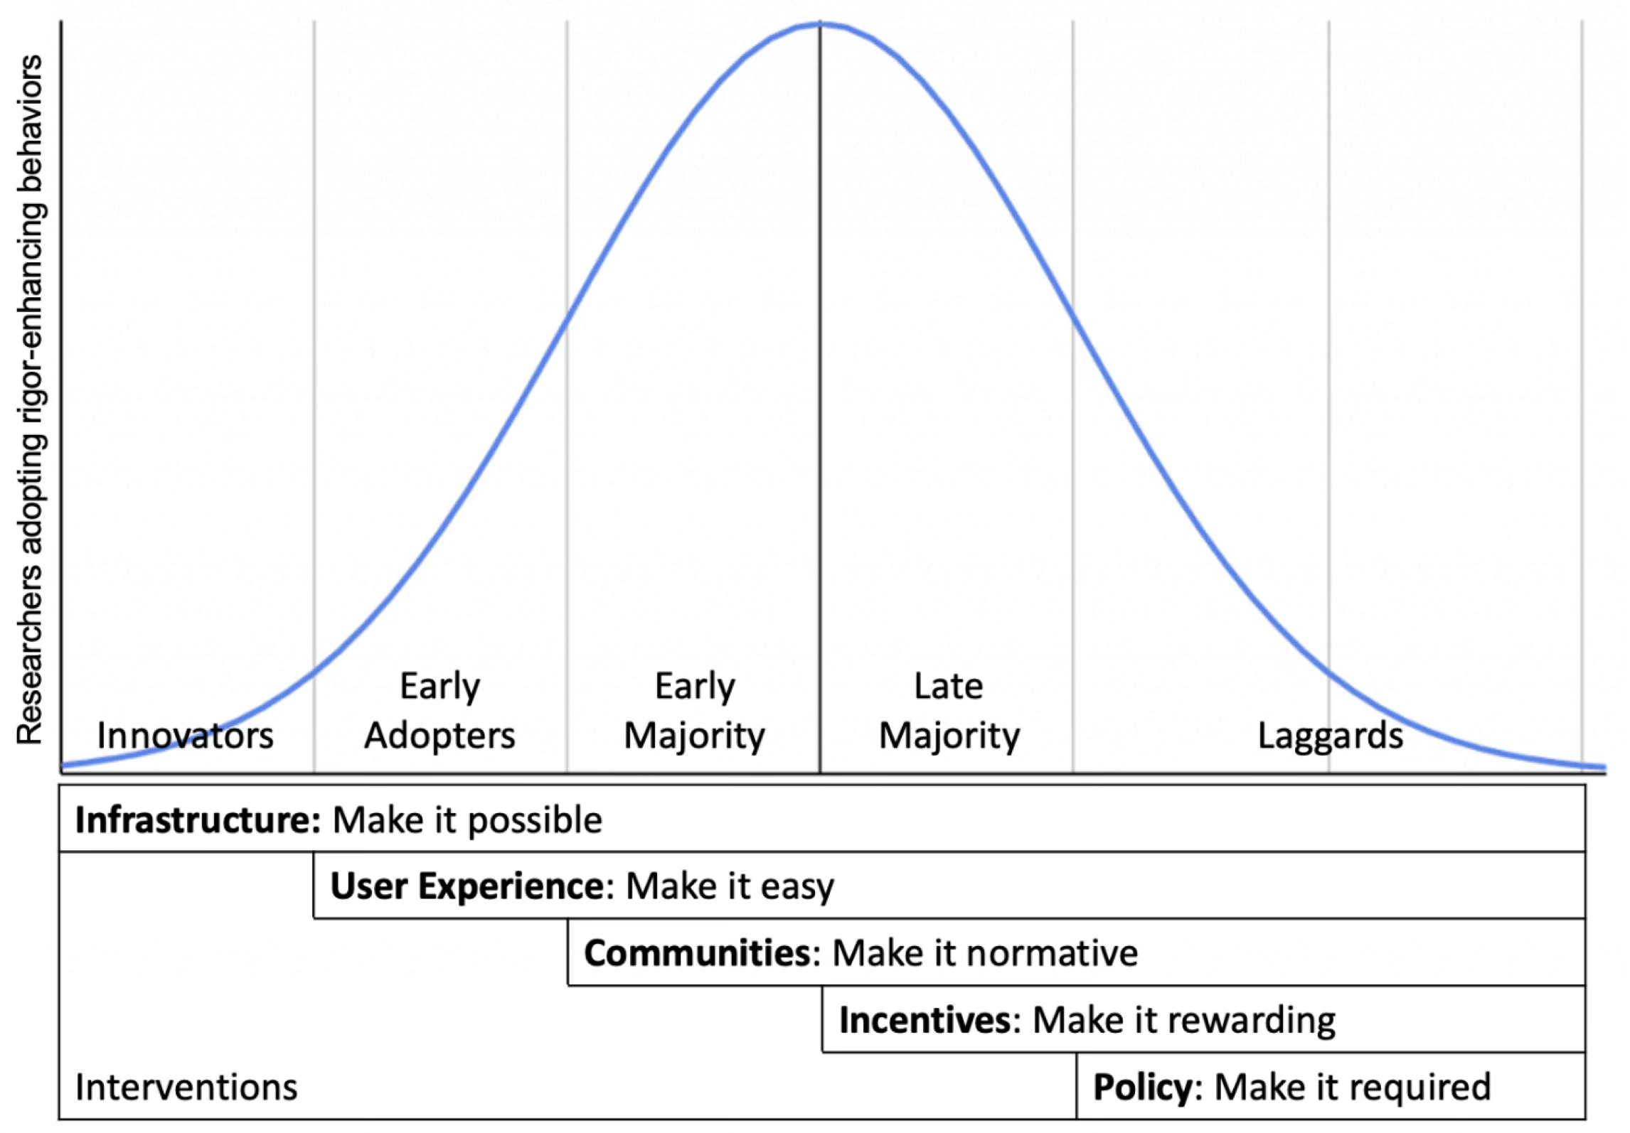
(Nosek et al., 2021)
Notes:
It is thought that Open Science thus improves the way we conduct science. For over a decade, researchers that were intrinsically motivated to conduct OS, have been involved in open science practices. However, the transition to OS has been slow. For large scale adoption of OS practices it is important that we reach people beyond the innovators and early adopters. We need people just outside of the OS bubble get involved.

Slide 11


Expert
Interested
Notes:
This group of researchers, the interested, are the target audience for OSCU. However, we also need experts to be part of our community. Experts might want to share experience and knowledge among themselves but we also need people with a little more experiences to help those researchers that are interested in OS.

Slide 12

Goals Open Science Community
Make Open Science more visible and accessible
Promote peer-to-peer knowledge exchange
Inspire and enable researchers to take the next small step
Identify obstacles and need for support to inform policy makers
Notes:
Facilitates you in finding colleagues that are just one step ahead of you and that can help you take the first or next small step.

Slide 13
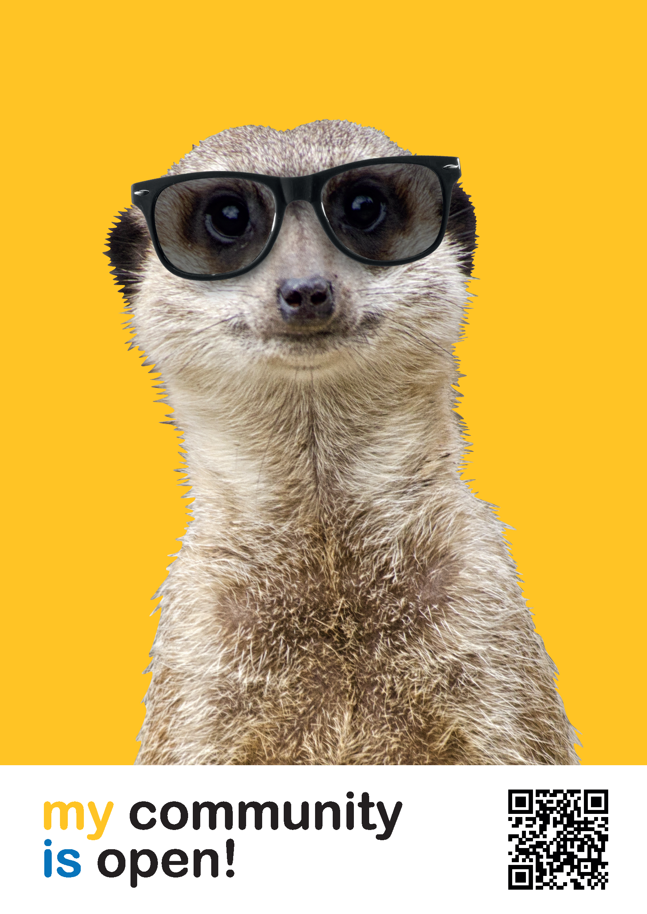

Slide 14











Slide 15
The future is open!
→ openscience-utrecht.com

